Slide 1
Hamstring Stretch
Place your heel on the opposite side keeping your torso facing forward.
Cross your leg in front of your body keeping your torso facing forward.
Place your heel on a stair.
Hold: Reps:
Sets: Times/day:

Slide 2
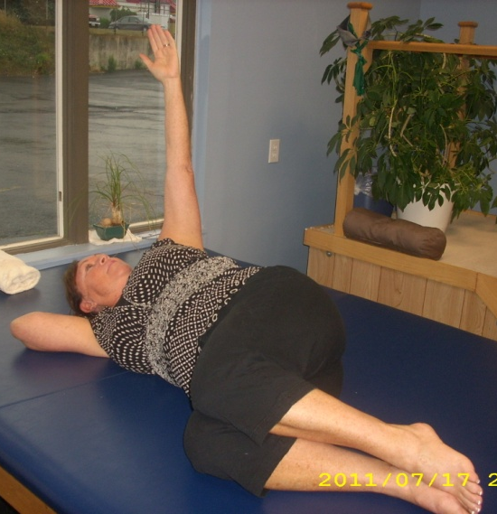
Fetal Roll Back
Lay on your side. Curl your knees up toward your chest. Slowly swing your arm from the front to the back looking over your shoulder as you go. Slowly bring it back to the front.
Hold: Reps:
Sets: Times/day:

Slide 3
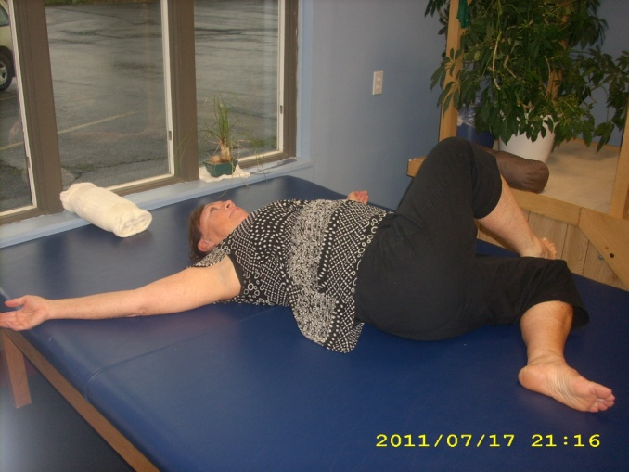
Cross Knee Rock
Lay on your back. Cross one foot over one leg. Roll your legs to one side. Return to the middle. Roll your legs to the other side.
Hold: Reps:
Sets: Times/day:

Slide 4
Dollar Stretch
Place one foot up on a chair. Bend forward and reach toward the floor with both hands.
Hold: Reps:
Sets: Times/day:

Slide 5
Half Wimpies
Place one leg straight behind you up on a table.
Step forward with the leg you are standing on.
Push your body up off the table with your hand.
Keep your torso facing forward.
Hold: Reps:
Sets: Times/day:

Slide 6
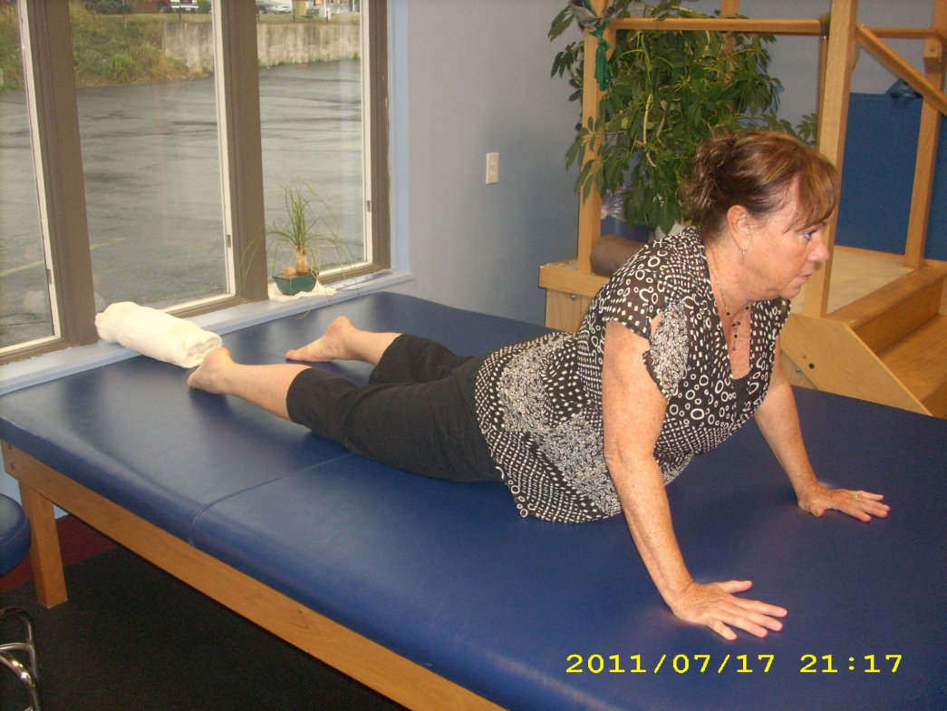
Wimpie Push Up
Lay on your stomach with your legs straight.
Push your torso off the table with your hands.
Keep your hips down on the table.
Hold: Reps:
Sets: Times/day:

Slide 7
Pretzel Stretch
Get on your hands and knees. Cross one leg behind the other. Slide the back leg out straight behind you. Point the front foot out to the side. Lean over your front knee.
Hold: Reps:
Sets: Times/day:

Slide 8
Heel Squish
Sit on your heels with your toes pointed.
Hold: Reps:
Sets: Times/day:

Slide 9
Toe Jams
Press your toes against a wall.
Sit on your heels with your toes bent upward under you.
Hold: Reps:
Sets: Times/day:

Slide 10
90x90 Stretch
Place your forearm on a doorframe. Make a 90° angle at your elbow and a 90° angle at your armpit. Turn your body away from that arm.
Hold: Reps:
Sets: Times/day:

Slide 11
Waist Band Turn In
Place your hand behind your back in your waist band. Place the back of your elbow on a doorframe. Turn in toward your arm.
Hold: Reps:
Sets: Times/day:

Slide 12
Window Stretch
Place your forearm on the wall in front of you with a 90° angle at your elbow and a 90° angle at your armpit. Turn in toward your arm.
Hold: Reps:
Sets: Times/day:

Slide 13
Counter Stretch
Place your hand upside down on a countertop directly behind you and straighten your elbow.
Hold: Reps:
Sets: Times/day:

Slide 14
Frog Stretch
Get on your hands and knees. Spread your knees and feet apart. Lean down to your forearms.
Hold: Reps:
Sets: Times/day:

Slide 15
Prayer Stretch
Get on your hands and knees and lean back on your heels.
Hold: Reps:
Sets: Times/day:

Slide 16
Sumo Squat ***
Standing spread your knees apart with your feet facing outward. Squat down keeping your back straight.
Hold: Reps:
Sets: Times/day:

Slide 17
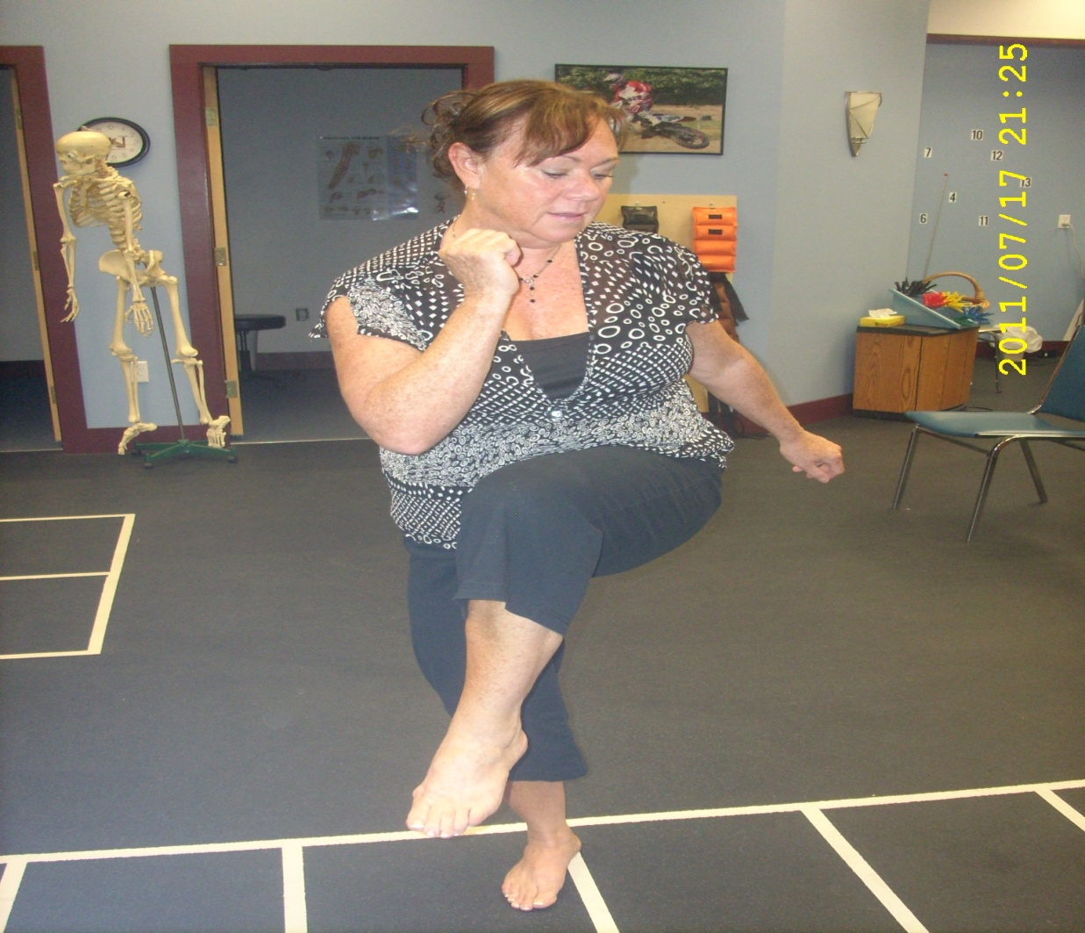
Tribal Squats
Go into a squat position with your back straight. Bring your knee up to the opposite elbow. Return to squat position. Bring other knee to opposite elbow.
Hold: Reps:
Sets: Times/day:

Slide 18
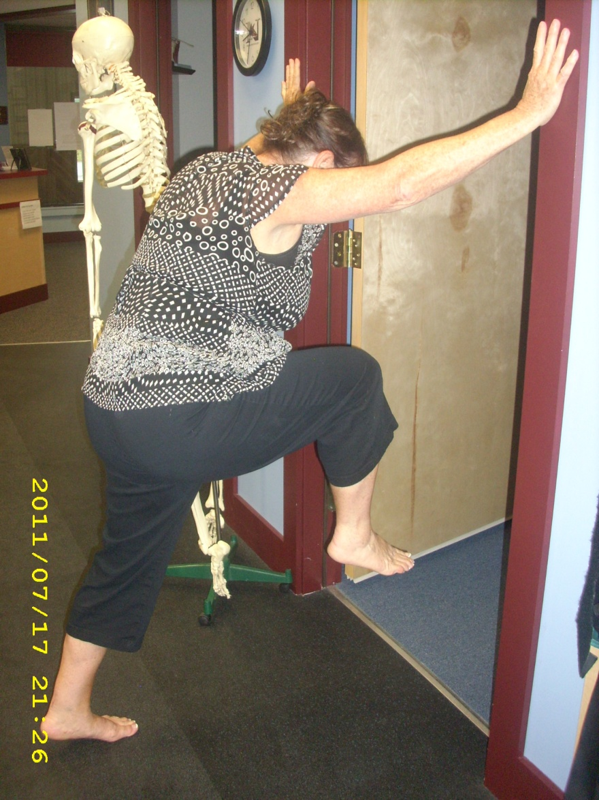
Doorway Marches
Lean forward with your hands on a doorway. Bring one knee toward your chest in a marching motion coming up on your toe with the standing foot. Bring down and repeat with other leg.
Hold: Reps:
Sets: Times/day:

Slide 19
Butt on Wall Stretch
Lay on your back. Put one foot flat on the wall and cross the other foot over your knee. Bring your butt as close to the wall as you can.
Hold: Reps:
Sets: Times/day:

Slide 20
Table Sit Stretch
Place the outside of your lower leg on a table in front of you. Pull your foot across so your knee is in line with the middle of your torso. Lean forward over your knee.
Hold: Reps:
Sets: Times/day:

Slide 21
Corner Stretch
Put one foot in the corner. Place your forearms on both walls. Make a 90° angle at your elbows and a 90° angle at your armpits. Lean your body forward supporting your weight with your leg not your arms.
Hold: Reps:
Sets: Times/day:

Slide 22
Figure 4 Stretch
Lay on your back with your knees bent. Cross one foot over your knee and apply pressure downward to your knee.
Hold: Reps:
Sets: Times/day:

Slide 23
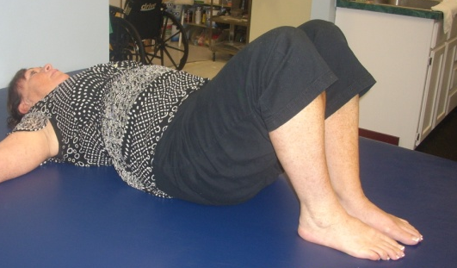
Knee Rocks
Lay on your back with your knees bent at together. Let them slowly fall to one side. Return to the center. Repeat to the other side.
Hold: Reps:
Sets: Times/day:

Slide 24
Monster Walk
With a band around your lower legs get into the squat position. Keep your back upright and straight. Side step slowly.
Hold: Reps:
Sets: Times/day:

Slide 25
Cross Over
Lay on your back with your legs straight. Bend one knee and cross is over the other leg. Pull this knee outward and upward.
Hold: Reps:
Sets: Times/day:

Slide 26
Hitch Hikers
Lay on your back with your arm out to the side in line with your shoulder. Use a weight to hold your arm in this position. Bend your elbow to 90° and slowly bring your hand backward and forward.
(A weight may/may not be needed)
Hold: Reps:
Sets: Times/day:

